Slide 1
Retrieving the Client’s IP and Port number
Faculty: Dr. Asif Uddin Khan

Slide 2
Retrieving the Client’s IP and Port number
Functions used
getpeername(): Gets the address of the client connected to the socket.
inet_ntop(): Converts the IP address from binary form to a human-readable string.
ntohs(): Converts the port number from network byte order to host byte order.

Slide 3
getpeername()
int getpeername(int sockfd, struct sockaddr *addr, socklen_t *addrlen);
sockfd: The file descriptor of the socket for which you want to get the peer's address.
addr: A pointer to a sockaddr structure where the peer's address will be stored.
addrlen: A pointer to a socklen_t variable that initially contains the size of the sockaddr structure and will be updated to the size of the address returned.

Slide 4
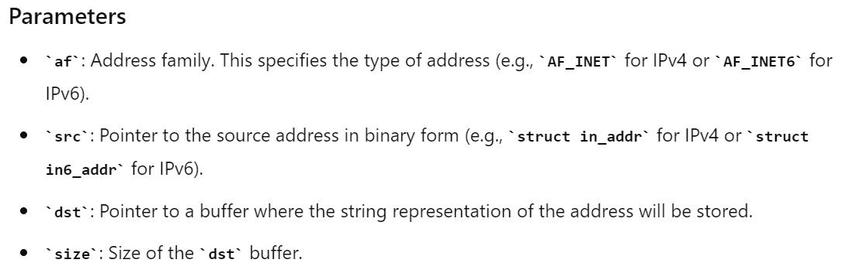

const char *inet_ntop(int af, const void *src, char *dst, socklen_t size);

Slide 5
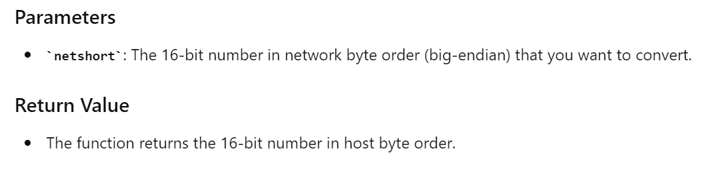
uint16_t ntohs(uint16_t netshort);

Slide 6
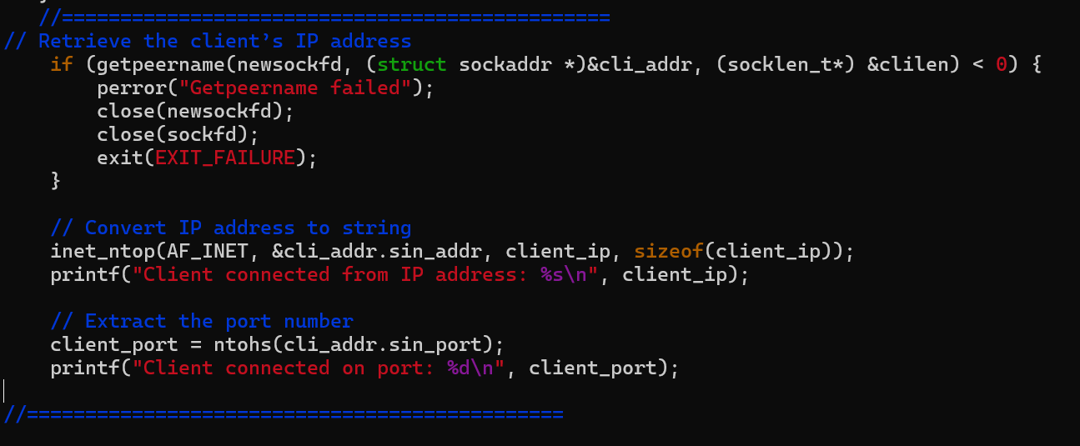
Example

Slide 7
Example: Retrieving the Client’s IP
char client_ip[INET_ADDRSTRLEN]; // declare in declaration section of the program
if (getpeername(newsockfd, (struct sockaddr *)&cli_addr, &clilen) < 0) {
perror("Getpeername failed");
close(newsockfd);
close(sockfd);
exit(EXIT_FAILURE);
}
// Convert IP address to string
inet_ntop(AF_INET, &cli_addr.sin_addr, client_ip, sizeof(client_ip));
printf("Client connected from IP address: %s\n", client_ip);

Slide 8
Example: Extract the Client’s port number
int client_port; // declare in declaration section of the program
// Extract the port number
client_port = ntohs(cli_addr.sin_port);
printf("Client connected on port: %d\n", client_port);

Slide 9
Assignment-4
Write a TCP client server socket program in C for following task.
Client sends a message to the server
Server should print clients IP address and Port number and the received message.

